Slide 1
COMPUTATIONAL THINKING USING ARDUINO
Blinking LEDs in pattern

Slide 2

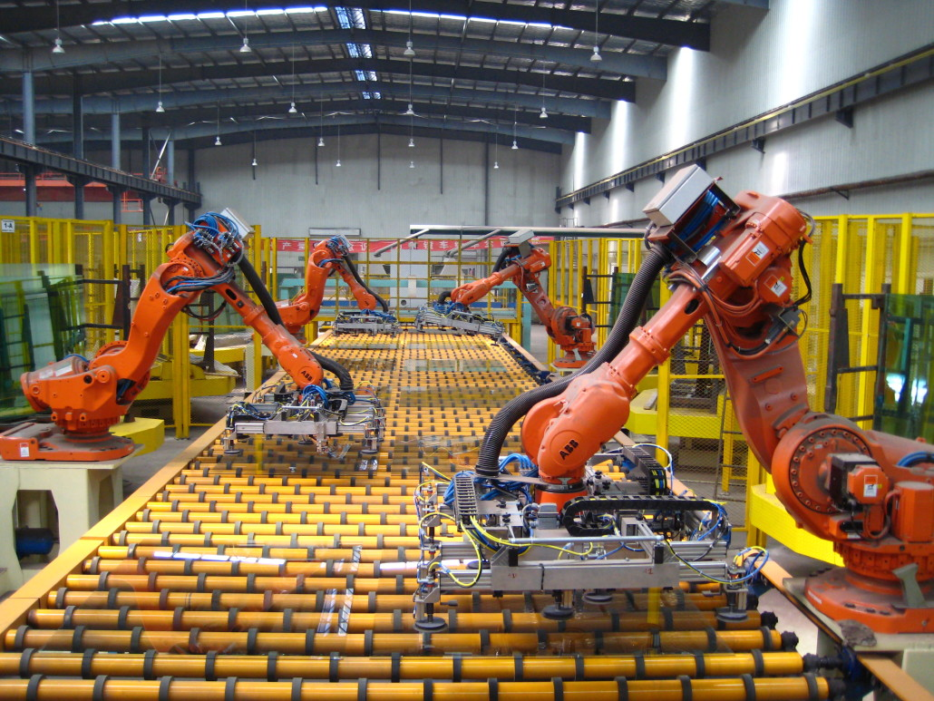
Computational Thinking (CT) is the thought processes involved in formulating a problem and expressing its solution in such a way that a computer (human or machine) can effectively carry out.
A computer is a device or a person that can be instructed to carry out an arbitrary set of operations automatically

Slide 3
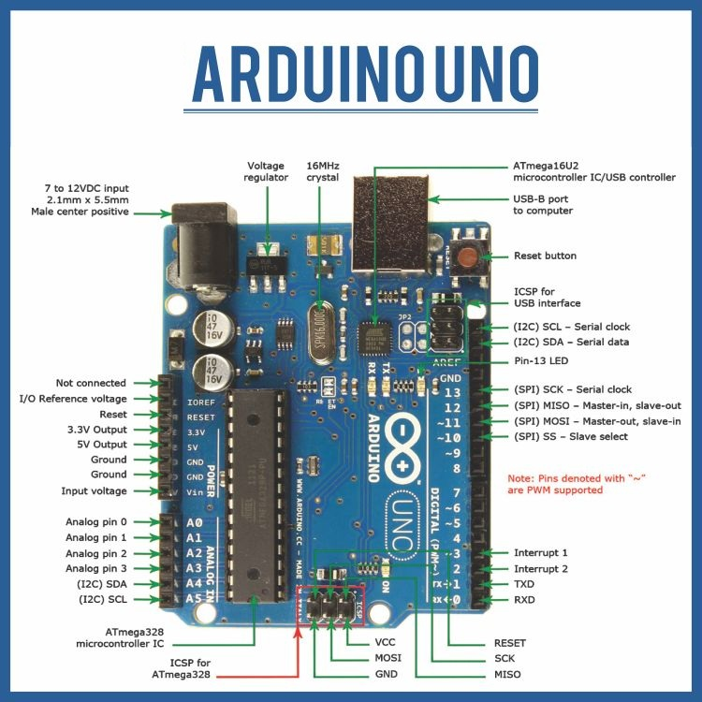
What is Arduino?
An inexpensive and small circuit board which has a tiny computer on it. This tiny computer is called a microcontroller. The microcontroller is an integrated circuit. You can program it using your Laptop.

Slide 4
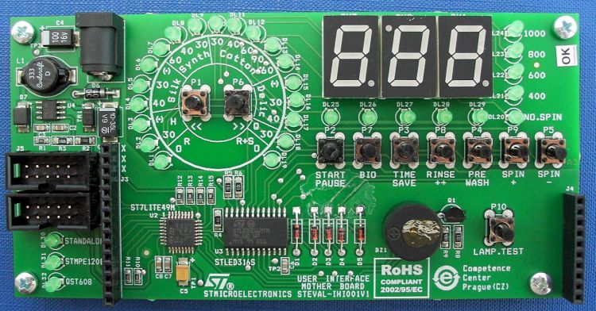
What is Microcontroller?
Integrated Circuits are tiny black chips on circuit boards. Those ICs that can act as a computer without any external help from other chips are called Microcontrollers.

Slide 5
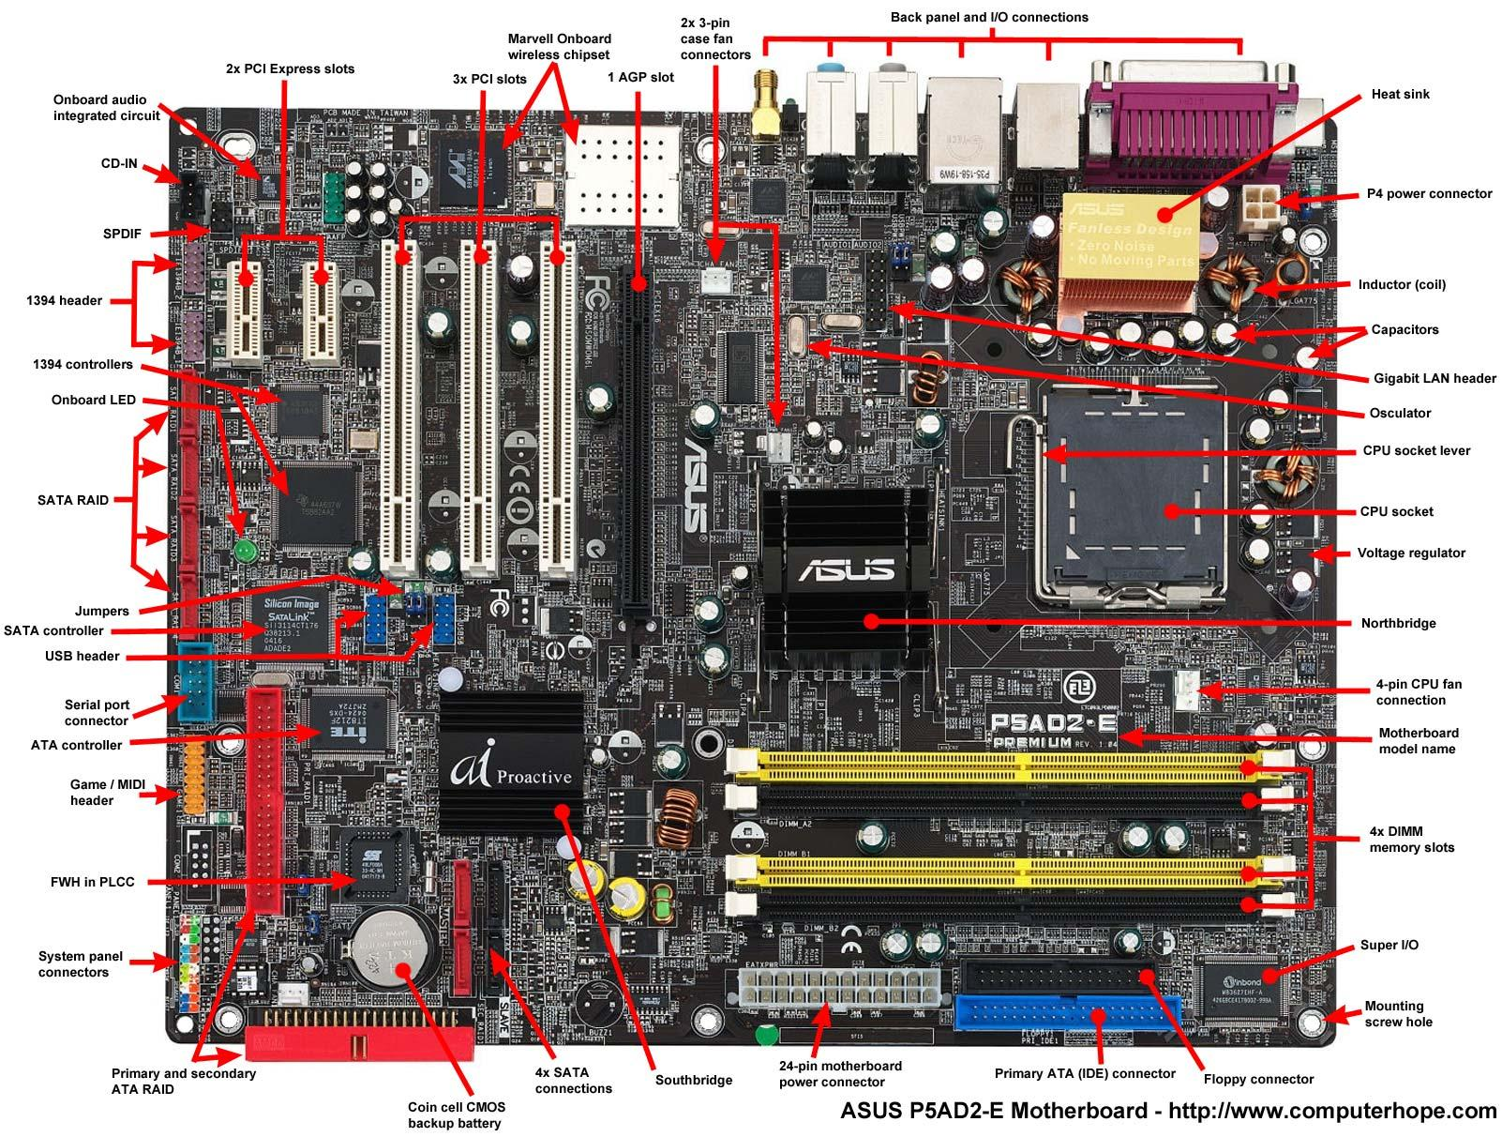
What is Microprocessors?
Those chips which require help from other chips to form a computer are called Microprocessors.

Slide 6
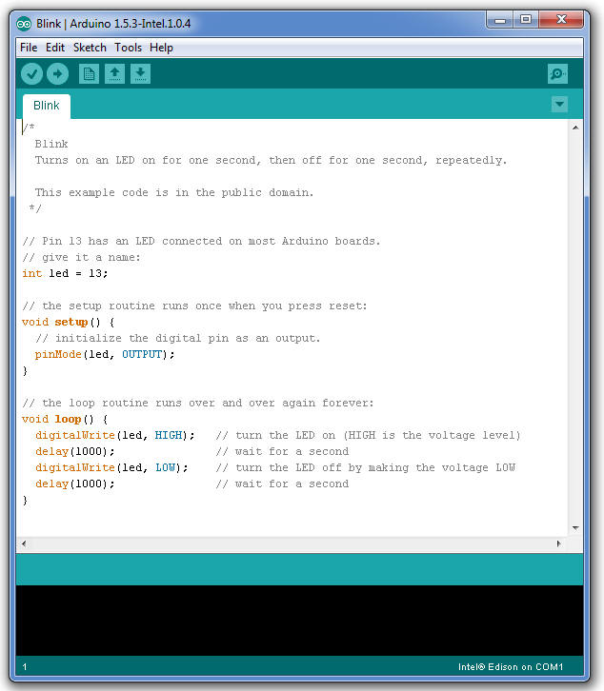

What is Programming?
Writing a set of instructions and putting it inside the Arduino so that it can execute it. It is like creating a Recipe for cooking a dish.

Slide 7

What kind of problems can I solve using Arduino?

Slide 8
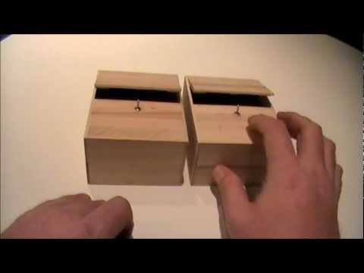
What kind of problems can I solve using Arduino?

Slide 9
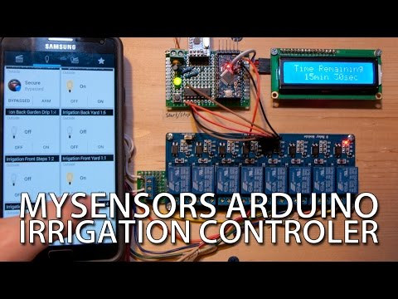
What kind of problems can I solve using Arduino?

Slide 10
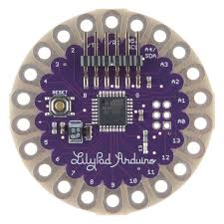
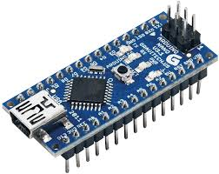
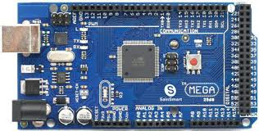
What are the various Arduino Board?

Slide 11
What problem will we solve today?
For today’s session:
Our Computer: Arduino UNO
Our Problem: Read graphs, understand patterns and Blink LEDs

Slide 12
Stages of Computational Thinking?
[1] Computational Thinking is an iterative process based on three stages:
Problem Formulation (abstraction), Solution Expression (automation), Solution Execution & Evaluation (analyses) captured by the figure to the right.

